Slide 1

算法设计与分析 (Algorithm Design and Analysis) 王永才

Slide 2
目录
课程介绍
算法绪论
初识算法设计与分析

Slide 3
课程介绍
教师：
王永才：18910215881，ycw@ruc.edu.cn
助教：
吕筱玮
lvxiaowei@ruc.edu.cn
刘 帅
rucliushuai@ruc.edu.cn

Slide 4


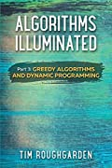
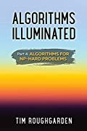

课程介绍
教材：
参考资料
《算法详解1》算法基础
http://algorithmsilluminated.org
《算法详解2》图算法和数据结构
《算法详解3》贪婪算法和动态规划
《算法详解4》NP-hard问题的算法
《算法导论》第三版
https://stanford-cs161.github.io/winter2022/lectures/

Slide 5

成绩组成
课程作业 | 40%
YOJ实验 | 40%
课堂讲论文 | 20%
期末考试 | 75%
期末报告 | 25%
平时作业、实验、课堂讲论文：60%
期末报告：10%
期末考试：30%

Slide 6
课程内容
导论 | 渐进复杂性分析，渐进符号体系
递归与分治 | 主定理分析，最大子数组，矩阵乘法
线性时间的选择 | 线性时间选择算法，替换法证明
随机算法 | 随机算法、BogoSort、QuickSort、随机算法复杂度分析、比较类排序算法的复杂度下界、O(n)时间排序算法。
搜索树与K-D树 | 二叉搜索树，红黑树和K-D 树。
高维数据搜索 | 范围搜索树(Range Tree), Quad Tree。
最近邻搜索 | K-D Tree 上最近邻搜索，Quad-Tree 上的最近邻搜索算法
哈希与布隆过滤器 | 哈希表、哈希表的冲突避免机制，布隆过滤器
局部敏感哈希 | 局部敏感哈希的原理和实现方法，基于局部敏感哈希的近似最近邻搜索
MinHash | 介绍MinHash 和基于MinHash 的相似文本查找
图上搜索算法 | DFS 查找强连通分量，图的三连通分量查找的快速算法，SPQR-TREE 方法
贪心算法 | 最优子结构，最优调度，霍夫曼编码，次模性，满足单调次模性的问题
动态规划1 | Bellman-ford 算法，Floyd 算法等
动态规划2 | 最长公共子序列，背包问题，树中的独立集合
近似算法 | NP-Hard 问题与近似算法
大图分析算法 | 大规模图的稠密子图的查找算法，k-core, KVCC, K-clique
课堂论文报告 | 算法相关前沿论文选读和报告

Slide 7
为什么要学习算法?
在绝大多数计算机科学分支中，要完成任何实质性的工作，理解算法的基础知识并掌握与算法相关的数据结构都是必不可少的。
例如：
通讯网络中的最短路算法
公钥加密需要高效的数论算法
计算机图像学需要用到几何算法
数据库索引需要用到平衡搜索树这种数据结构
优化调度领域需要用到动态规划算法

Slide 8
为什么要学习算法？
算法是技术革新的推动力
在大数据时代，虽然处理器速度在快速提升，但是算法的改进所获得的性能提升远远高于处理器速度的极具增加带来的性能提升，在大数据时代，高效的算法就更加重要。
算法对其它学科产生影射
高效的计算机算法也是在推动集成电路、生物学、智能制造等行业的发展。
学习算法有益思维
算法很有趣

Slide 9
本节课主要内容
整数乘法
Karatsuba 乘法
InsertionSort算法
算法复杂度渐进性分析

Slide 10
整数乘法
1234567895931413
4563823520395533
x

Slide 11
整数乘法
n
1233925720752752384623764283568364918374523856298
4562323582342395285623467235019130750135350013753
x
小学乘法计算这个问题速度有多快
???
需要进行多少次基本操作呢？
这里我们考虑1対1的乘法，1对1的加法都是一个基本操作

Slide 12
整数乘法
44
97
第二行的每个数与第一行进行计算时，需要进行
n次乘法，最多n次加法：每个数有2n个基本操作
x
共需要计算n个数，总操作个数2n²
308
396
我们对得到的n行数逐列求和。
每列最多n个操作
+
最多有2n列
求和过程也是2n²个基本操作
4268
所以总体上我们需要进行4n²个操作

Slide 13

整数乘法
n
1233925720752752384623764283568364918374523856298
4562323582342395285623467235019130750135350013753
x
基本操作数量 <=（常数） $n^{2}$
我们称计算复杂度为O(n²)
“runs in time O(n²)”
后面我们再介绍大O表示法的详细定义
Notes:
Formal definition coming Wednesday!
Informally, big-Oh notation tells us how the running time scales with the size of the input.

Slide 14
我们用Python实现小学整数乘法，看它的运行时间
运行时间 看似确实是以 n²增长的
Looks like it’s roughly
T_{laptop}(n) = 0.0063 n² – 0.5 n + 12.7 ms...

Slide 15


我们手算小学整数乘法，虽然这次慢很多，但是计算时间随n变化的趋势上是什么呢？
仍然是随着n的增大呈n²级时间增长的
Some other quadratic function of n
T_{laptop}(n) $≈$
0.0063 n² – 0.5 n + 12.7 ms
Notes:
It totally takes me less than 30 seconds to multiply two 500-digit numbers…

Slide 16


大O( )表示符的有效性
如果某个天才实现的小学整数乘法是O(n^{1.6})的，在n比较小的时候，他的算法的运行时间可能比O(n²)的算法运行时间还长。
Wizard’s algorithm
$≈\frac{n^{1.6}}{10}+100$
$$≈.0063n^{2}$$
Notes:
It totally takes me less than 30 seconds to multiply two 500-digit numbers…

Slide 17
但当让n更大的时候
O(n^{1.6})的算法，在n达到某个足够大的值之后，运行时间就会少于O(n²)的算法。
$≈\frac{n^{1.6}}{10}+100$
Time (ms)
$$≈.0063n^{2}$$
Wizard’s algorithm

Slide 18

既然O(n^{1.6})的算法比O(n²)的算法好，我们能否设计比O(n²)计算复杂度低的整数乘法呢？
$$n^{2}$$
$$n$$

Slide 19
分治算法
把大的问题拆成小的子问题
Big problem
Smaller problem
Smaller problem
Yet smaller problem
Yet smaller problem
Yet smaller problem
Yet smaller problem

Slide 20



基于分治的整数乘法
假设我们考虑的整数是2^{k}位的，我们把整数拆成两部分
1234 = 12$×$100 + 34
1234$×$5678
= ( 12$×$100 + 34 ) ( 56$×$100 + 78 )
= ( 12$×$56 )10000 + ( 34$×$56 + 12$×$78 )100 + ( 34$×$78 )
1
2
3
4
1个四位整数乘法
4个2位整数乘法

Slide 21
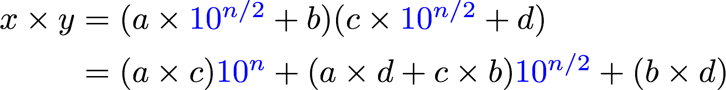
更一般的
我们假设n是偶数
一个n位整数可以进行如下拆分:
1
2
3
4
一个 n-digit 乘法
四个 (n/2)-digit 乘法

Slide 22

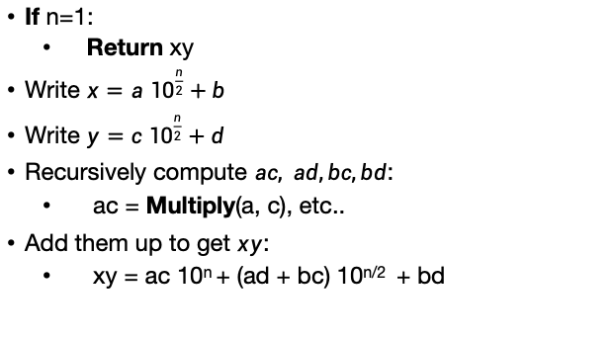
分治算法 我们不精确的假设n是2的幂数
x,y are n-digit numbers
Multiply($x$, $y$):
If n=1:
Return xy
Write $x=a {10}^{\frac{n}{2}}+b$
Write $y=c {10}^{\frac{n}{2}}+d$
Recursively compute $ac, ad,bc,bd$:
ac = Multiply(a, c), etc..
Add them up to get $xy$:
xy = ac 10^{n} + (ad + bc) 10^{n/2} + bd
a, b, c, d are
n/2-digit numbers
我们怎么处理n是奇数的时候？
怎么计算与 10^{n}的乘法?
See the Lecture 1 Python notebook for actual code!

Slide 23

我们可以继续这个拆分的过程
把一个4-digit 整数乘法，拆分为四个2-digit整数乘法
我们可以继续拆分每个2-digit整数乘法问题, 拆成1位整数乘法问题。
会拆分出多少个1位整数乘法呢？
1234$×$5678

Slide 24
递归树
16 个1位整数乘法
4 digits
2 digits
2 digits
2 digits
2 digits
1 digit
1 digit
1 digit
1 digit
1 digit
1 digit
1 digit
1 digit
1 digit
1 digit
1 digit
1 digit
1 digit
1 digit
1 digit
1 digit

Slide 25
用这个分治递归的算法计算效率究竟如何呢？
会比之前的小学整数乘法的方法好么?
怎么回答这个问题呢?
编个程序试一下.
理论上分析一下.

Slide 26
1. 编程试一下.
Check out the Lecture 1 IPython Notebook
Conjectures about running time?
Doesn’t look too good but hard to tell…
Maybe one implementation is slicker than the other?
Maybe if we were to run it to n=10000, things would look different.
Something funny is happening at powers of 2…

Slide 27
2. Try to understand the running time analytically
我们看到，将4位数字相乘可以得到16个1位数字的乘法。
把8位数相乘怎么样？
你怎么看待n位数？

Slide 28
Recursion Tree
64 one-digit multiplies!
8 digits
4 digits
4 digits
4 digits
4 digits
2 digit
2 digit
2 digit
2 digit
2 digit
2 digit
2 digit
2 digit
2 digit
2 digit
2 digit
2 digit
2 digit
2 digit
2 digit
2 digit
1
1
1
1
1
1
1
1
1
1
1
1
1
1
1
1
1
1
1
1
1
1
1
1
1
1
1
1
1
1
1
1
1
1
1
1
1
1
1
1
1
1
1
1
1
1
1
1
1
1
1
1
1
1
1
1
1
1
1
1
1
1
1
1

Slide 29
2. Try to understand the running time analytically
Claim:
The running time of this algorithm is
AT LEAST n² operations.

Slide 30

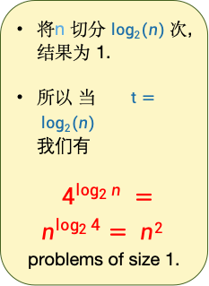
Proof：There are n² 1-digit problems
1 problem
of size n
将n 切分 $log2(n)$次, 结果为 1.
所以 当 $t= log2(n)$
我们有
$4^{\log_{2}{n}} =n^{\log_{2}{4}}= n2$
problems of size 1.
4 problems
of size n/2
…
4^{t} problems
of size n/2^{t}
Note: this is just a cartoon – I’m not going to draw all 4^{t} circles!
…
____ problems
of size 1

Slide 31

这有点让人失望 用分治的方法仍然至少需要 $O\left(n^{2}\right)次基本计算$
$$n^{2}$$
But wait!!
$$n$$

Slide 32
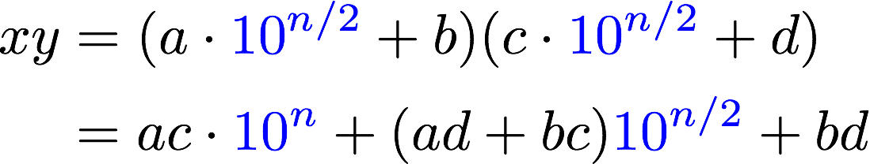
分治的方法实际上是可以提高效率的
Karatsuba 提出一种更快的基于分治的整数乘法
我们可以在每一层分治成3个子任务
需要计算这三项

Slide 33
Karatsuba 整数乘法
递归计算如下三个数:
ac
bd
(a+b)(c+d)
减掉这两项
得到第三项
(a+b)(c+d) = ac + bd + ad + bc
Assemble the product:

Slide 34
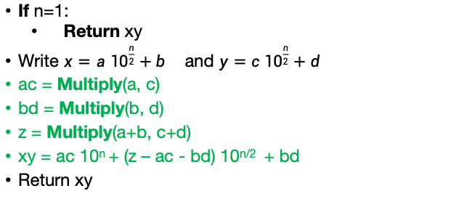
算法伪码
x,y are n-digit numbers
仍然假设n是2的幂次数
Multiply($x$, $y$):
a, b, c, d are
n/2-digit numbers
If n=1:
Return xy
Write $x=a {10}^{\frac{n}{2}}+b$ and $y=c {10}^{\frac{n}{2}}+d$
ac = Multiply(a, c)
bd = Multiply(b, d)
z = Multiply(a+b, c+d)
xy = ac 10^{n} + (z – ac - bd) 10^{n/2} + bd
Return xy

Slide 35

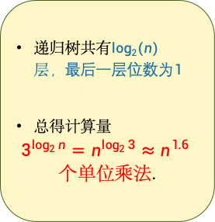
运算时间分析?
递归树共有$log2\left(n\right)层，最后一层位数为1$
总得计算量
$$3^{\log_{2}{n}}=n^{\log_{2}{3}}≈n^{1.6}$$
$个单位乘法$.
1 problem
of size n
3 problems
of size n/2
…
3^{t} problems
of size n/2^{t}
Note: this is just a cartoon – I’m not going to draw all 3^{t} circles!
…
We aren’t accounting for the work at the higher levels! But we’ll see later that this turns out to be okay.
$$n^{1.6}$$
____ problems
of size 1

Slide 36

This is much better!
$$n^{2}$$
$$n^{1.6}$$
$$n$$

Slide 37
We can even see it in real life!

Slide 38
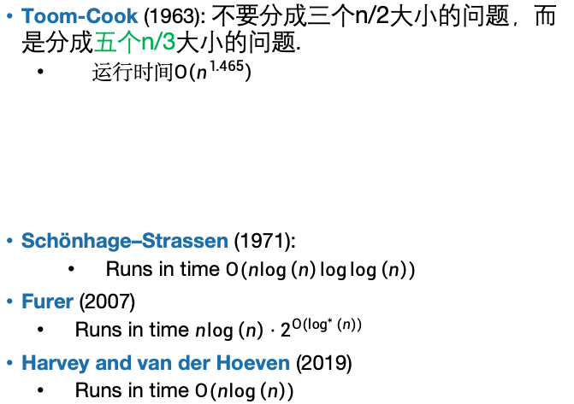
我们可以做的更好么?
Toom-Cook (1963): 不要分成三个n/2大小的问题，而是分成五个n/3大小的问题.
运行时间$O\left(n^{1.465}\right)$
Schönhage–Strassen (1971):
Runs in time $O(n\log\left(n\right)\log{\log\left(n\right)) }$
Furer (2007)
Runs in time $n\log\left(n\right)⋅2^{{O(log}^{∗}\left(n\right)) }$
Harvey and van der Hoeven (2019)
Runs in time $O(n\log\left(n\right))$
Try to figure out how to break up an n-sized problem into five n/3-sized problems! (Hint: start with nine n/3-sized problems).
Given that you can break an n-sized problem into five n/3-sized problems, where does the 1.465 come from?
Ollie the Over-achieving Ostrich
Siggi the Studious Stork
[This is just for fun, you don’t need to know these algorithms!]

Slide 39
本节课主要内容
整数乘法
Karatsuba 乘法
InsertionSort算法
算法复杂度渐进性分析

Slide 40
排序
排序是算法中重要的基础问题
我们先假设所有待排序的数字是不同的.
6
4
3
8
1
5
2
7
1
2
3
4
5
6
7
8
Length of the list is n

Slide 41
课前练习
def mysteryAlgorithmOne(A):
for x in A:
B = [None for i in range(len(A))]
for i in range(len(B)):
if B[i] == None or B[i] > x:
j = len(B)-1
while j > i:
B[j] = B[j-1]
j -= 1
B[i] = x
break
return B
这是哪个排序算法？
MergeSort
QuickSort
InsertionSort
BogoSort
def mysteryAlgorithmTwo(A):
for i in range(1,len(A)):
current = A[i]
j = i-1
while j >= 0 and A[j] > current:
A[j+1] = A[j]
j -= 1
A[j+1] = current
Notes:
这两个算法有什么区别？

Slide 42
课前练习
def mysteryAlgorithmOne(A):
for x in A:
B = [None for i in range(len(A))]
for i in range(len(B)):
if B[i] == None or B[i] > x:
j = len(B)-1
while j > i:
B[j] = B[j-1]
j -= 1
B[i] = x
break
return B
这是哪个排序算法
MergeSort
QuickSort
InsertionSort
BogoSort
def MysteryAlgorithmTwo(A):
for i in range(1,len(A)):
current = A[i]
j = i-1
while j >= 0 and A[j] > current:
A[j+1] = A[j]
j -= 1
A[j+1] = current

Slide 43
插入排序举例
6
4
3
8
5
从A[1]开始，将A[i] 向最左端移动，直到它已处于最左端，或者它左边的数小于它为止。
Then move A[3]:
6
4
3
8
5
3
4
6
8
5
4
6
3
8
5
3
4
6
8
5
Then move A[2]:
Then move A[4]:
4
6
3
8
5
3
4
6
8
5
3
4
6
8
5
3
4
5
6
8
Then we are done!

Slide 44
Insertion Sort
Does it work?
Is it fast?
What does that mean???
Plucky the Pedantic Penguin

Slide 45
The Plan
InsertionSort recap
Worst-case Analysis
Back to InsertionSort: Does it work?
Asymptotic Analysis
Back to InsertionSort: Is it fast?
MergeSort
Does it work?
Is it fast?

Slide 46
Claim: InsertionSort “works”
“Proof:” It just worked in this example:
6
4
3
8
5
6
4
3
8
5
3
4
6
8
5
4
6
3
8
5
3
4
6
8
5
4
6
3
8
5
3
4
6
8
5
3
4
6
8
5
3
4
5
6
8
Sorted!

Slide 47
Claim: InsertionSort “works”
“Proof:” I did it on a bunch of random lists and it always worked:

Slide 48
What does it mean to “work”?
Is it enough to be correct on only one input?
Is it enough to be correct on most inputs?
In this class, we will use worst-case analysis:
An algorithm must be correct on all possible inputs.
The running time of an algorithm is the worst possible running time over all inputs.

Slide 49
Worst-case analysis
Think of it like a game:
Here is my algorithm!
Algorithm:
Do the thing
Do the stuff
Return the answer
Here is an input!
(Which I designed to be terrible for your algorithm!)
Algorithm designer

Slide 50
Insertion Sort
Does it work?
Is it fast?
Okay, so it’s pretty obvious that it works.
HOWEVER! In the future it won’t be so obvious, so let’s take some time now to see how we would prove this rigorously.

Slide 51
Why does this work?
Say you have a sorted list, , and another element .
Insert right after the largest thing that’s still smaller than . (Aka, right after ).
Then you get a sorted list:
3
4
6
8
5
5
5
4
3
4
5
6
8

Slide 52
So just use this logic at every step.
6
4
3
8
5
4
3
8
5
The first element, [6], makes up a sorted list.
4
6
3
8
5
So correctly inserting 4 into the list [6] means that [4,6] becomes a sorted list.
4
6
3
8
5
The first two elements, [4,6], make up a sorted list.
3
4
6
8
5
So correctly inserting 3 into the list [4,6] means that [3,4,6] becomes a sorted list.
3
4
6
8
5
The first three elements, [3,4,6], make up a sorted list.
3
4
6
8
5
So correctly inserting 8 into the list [3,4,6] means that [3,4,6,8] becomes a sorted list.
3
4
6
8
5
The first four elements, [3,4,6,8], make up a sorted list.
3
4
5
6
8
So correctly inserting 5 into the list [3,4,6,8] means that [3,4,5,6,8] becomes a sorted list.
YAY WE ARE DONE!

Slide 53
This sounds like a job for…
Proof By Induction!

Slide 54
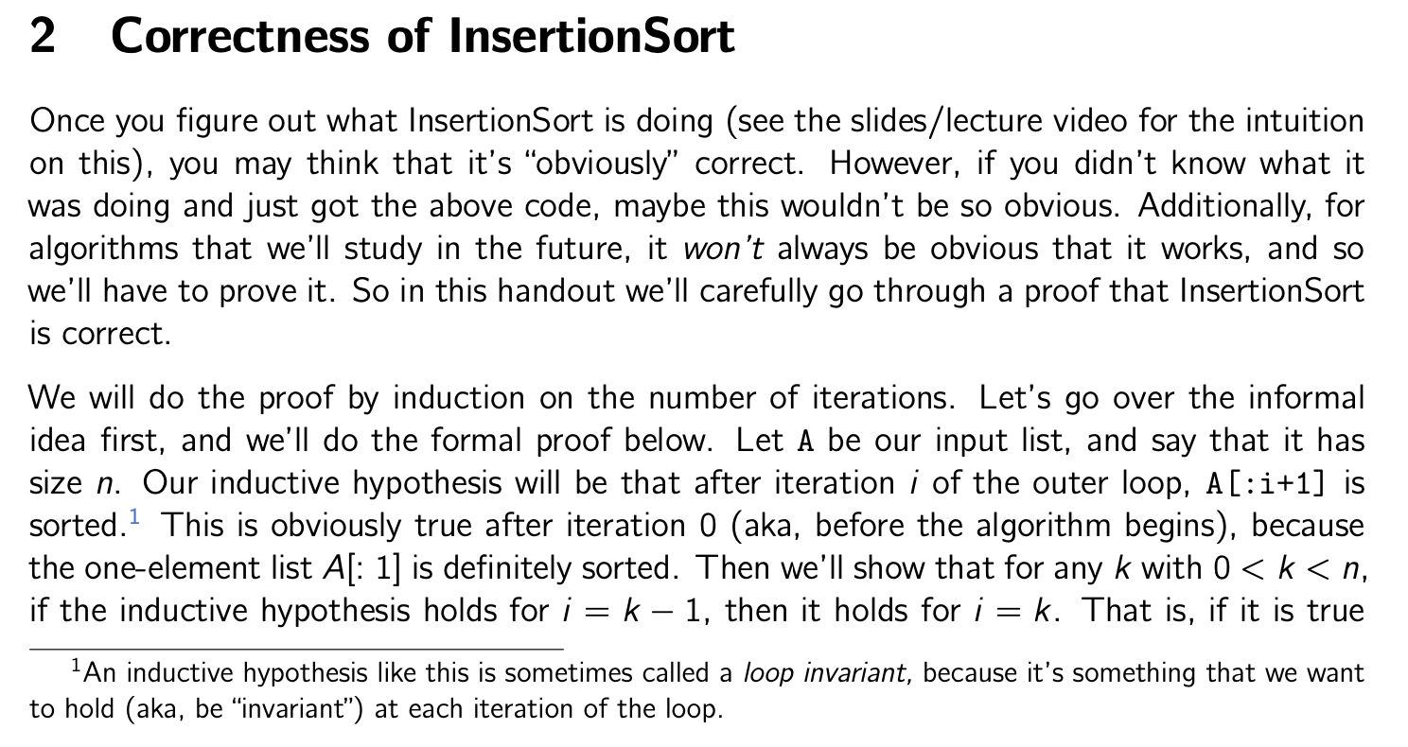
There is a handout with details!
See website!

Slide 55
归纳法证明的逻辑
假设A是一个长度为n的数组
归纳假设：
在外部循环的第i次迭代结束时，A[: i+1] 是有序的。
基本情况（i=0）：
在第0次迭代结束时，A[: 1] 是有序的。 ✓
归纳步骤：（这一步需要单独证明）
对于任意的 0 < k < n，如果归纳假设对于 i=k-1 成立，则对于 i=k 也成立。也就是说，如果在第 k-1 步中 A[: k] 是有序的，那么在第 k 步中 A[: k+1] 也是有序的。
结论：
归纳假设对于 i = 0, 1, ..., n-1 都成立。
特别地，它对于 i=n-1 也成立。
在第 n-1 次迭代结束时（也就是算法结束时），A[:n] = A 是有序的。
这正是我们想要的！ ✓
This logic
(see handout for details)
4
6
3
8
5
The first two elements, [4,6], make up a sorted list.
3
4
6
8
5
So correctly inserting 3 into the list [4,6] means that [3,4,6] becomes a sorted list.
This was iteration i=2.

Slide 56
这部分的总结
In this class we will use worst-case analysis:
We assume that a “bad guy” comes up with a worst-case input for our algorithm, and we measure performance on that worst-case input.
With this definition, InsertionSort “works”
Proof by induction!

Slide 57
本节课主要内容
整数乘法
Karatsuba 乘法
InsertionSort算法
算法复杂度渐进性分析

Slide 58
InsertionSort的速度如何?
实现测试:

Slide 59
实验测试的问题?
相同的算法因为实现的不同，可能会慢，也可能会快，依赖于实现的细节。
速度的快慢也受运行算法的计算机硬件设备的影响.
With this answer, “running time” isn’t even well-defined!

Slide 60
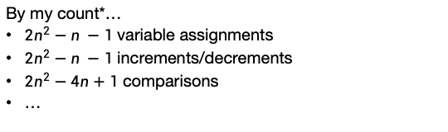
还有别的方法评价InsertionSort的速度么?
我们可以通过数基本操作的次数来评价算法!
def InsertionSort(A):
for i in range(1,len(A)):
current = A[i]
j = i-1
while j >= 0 and A[j] > current:
A[j+1] = A[j]
j -= 1
A[j+1] = current
By my count*…
$2n^{2}−n −1$ variable assignments
$2n^{2}−n −1$ increments/decrements
$2n^{2}−4n+1$ comparisons
…
*Do not pay attention to these formulas, they do not matter. Also not valid for bug bounty points.

Slide 61
这种方法的问题?
def InsertionSort(A):
for i in range(1,len(A)):
current = A[i]
j = i-1
while j >= 0 and A[j] > current:
A[j+1] = A[j]
j -= 1
A[j+1] = current
这太麻烦了也太乏味了
In order to use this to understand running time, I need to know how long each operation takes, plus a whole bunch of other stuff…
Counting individual
operations is a lot of work and doesn’t seem very helpful!

Slide 62
在算法分析中，我们使用渐进复杂度分析方法…
Big-Oh notation!
为我们提供了一种有意义的方法来讨论算法的运行时间，
它与编程语言、计算平台等无关，而无需计算所有操作。
主要思路
关注运行时如何随n（输入的大小）进行变化。

Slide 63
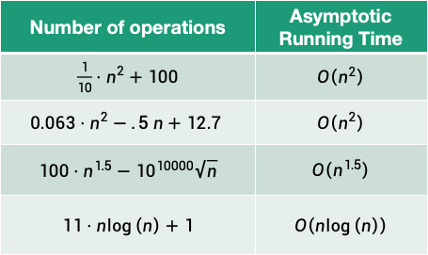
一些例子
(只考虑n的最高阶项，忽略低阶项，也忽略常数项和系数.)
Number of operations | Asymptotic Running Time
$\frac{1}{10}⋅n^{2}+100$ | $$O\left(n^{2}\right)$$
$$0.063⋅n^{2}−.5 n+12.7$$ | $$O\left(n^{2}\right)$$
$100⋅n^{1.5}−{10}^{10000}\sqrt{n}$ | $$O\left(n^{1.5}\right)$$
$$11⋅n\log\left(n\right)+1$$ | $$O\left(n\log\left(n\right)\right)$$
我们说这个算法比其他算法“渐近更快”。

Slide 64

为什么这是一个好的方法呢?
假设一个算法关于输入大小n的运行时间表达式:
$T\left(n\right)=10n^{2}+3n+7$ ms
这个常数因子10很大程度上取决于我的计算平台…
当n变大时，这些低阶项对总时间影响甚微。
我们只剩下n²项了！这才是有意义的。

Slide 65
渐近分析的优缺点
Pros:
Cons:
从硬件和语言特定问题中抽象出来。
使算法分析更容易处理。
允许我们有意义地比较算法在大型输入上的性能。
只有当n较大（与常数因子相比）时才有意义。
1000000000 n
is “better” than n² ?!?!

Slide 66
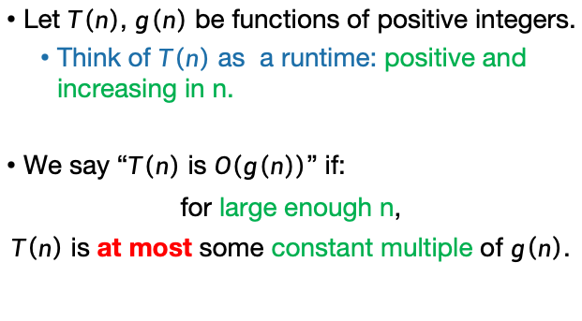
Informal definition for O(…)
pronounced “big-oh of …” or sometimes “oh of …”
Let $T\left(n\right)$, $g\left(n\right)$ be functions of positive integers.
Think of $T\left(n\right)$ as a runtime: positive and increasing in n.
We say “$T\left(n\right)$ is $O\left(g\left(n\right)\right)$” if:
for large enough n,
$T\left(n\right)$ is at most some constant multiple of $g\left(n\right)$.
Here, “constant” means “some number that doesn’t depend on n.”

Slide 67

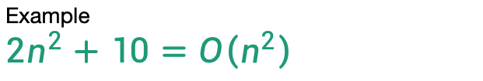
Example $$2n^{2}+10=O\left(n^{2}\right)$$
for large enough n,
$T\left(n\right)$ is at most some constant multiple of $g\left(n\right)$.
T(n) = 2n² + 10
g(n) = n²

Slide 68
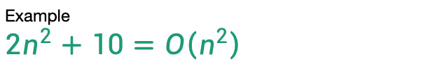
Example $$2n^{2}+10=O\left(n^{2}\right)$$
for large enough n,
$T\left(n\right)$ is at most some constant multiple of $g\left(n\right)$.
3g(n) = 3n²
T(n) = 2n² + 10
g(n) = n²

Slide 69
Example $$2n^{2}+10=O\left(n^{2}\right)$$
for large enough n,
$T\left(n\right)$ is at most some constant multiple of $g\left(n\right)$.
n₀=4
3g(n) = 3n²
T(n) = 2n² + 10
g(n) = n²

Slide 70
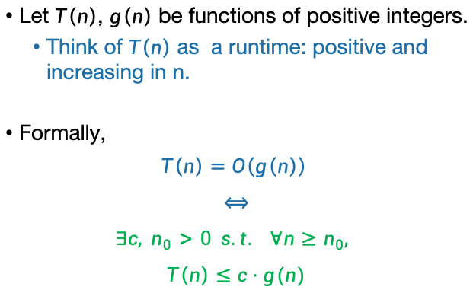
Formal definition of O(…)
Let $T\left(n\right)$, $g\left(n\right)$ be functions of positive integers.
Think of $T\left(n\right)$ as a runtime: positive and increasing in n.
Formally,
$$T\left(n\right)=O\left(g\left(n\right)\right)$$
$$⟺$$
$$∃c, n_{0}>0 s.t. ∀n≥n_{0},$$
$$T\left(n\right)≤c⋅g(n)$$

Slide 71

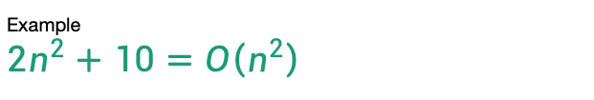
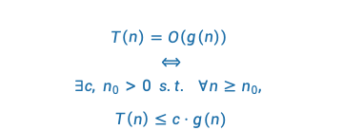
Example $$2n^{2}+10=O\left(n^{2}\right)$$
$$T\left(n\right)=O\left(g\left(n\right)\right)$$
$$⟺$$
$$∃c, n_{0}>0 s.t. ∀n≥n_{0},$$
$$T\left(n\right)≤c⋅g(n)$$
n₀=4
Formally:
Choose c = 3
Choose n₀ = 4
Then:
3g(n) = 3n²
T(n) = 2n² + 10
$$∀n≥4,$$
$$2n^{2}+10≤3⋅n^{2}$$
g(n) = n²

Slide 72


Same example $$2n^{2}+10=O\left(n^{2}\right)$$
$$T\left(n\right)=O\left(g\left(n\right)\right)$$
$$⟺$$
$$∃c, n_{0}>0 s.t. ∀n≥n_{0},$$
$$T\left(n\right)≤c⋅g(n)$$
Formally:
Choose c = 7
Choose n₀ = 2
Then:
7g(n) = 7n²
T(n) = 2n² + 10
$$∀n≥2,$$
$$2n^{2}+10≤7⋅n^{2}$$
g(n) = n²
There is not a “correct” choice of c and n₀
n₀=2
选择最紧的upper bound 倍数

Slide 73


O(…) is an upper bound: $$n = O(n2)$$
$$T\left(n\right)=O\left(g\left(n\right)\right)$$
$$⟺$$
$$∃c, n_{0}>0 s.t. ∀n≥n_{0},$$
$$T\left(n\right)≤c⋅g(n)$$
g(n) = n²
Choose c = 1
Choose n₀ = 1
Then
$$∀n≥1,$$
$$n≤n^{2}$$
T(n) = n

Slide 74
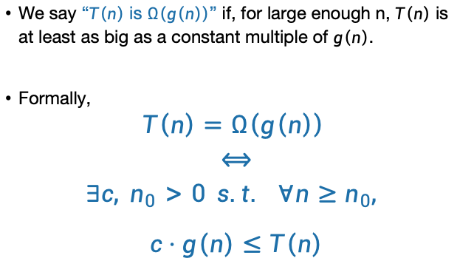
Ω(…) means a lower bound
We say “$T\left(n\right)$ is $Ω\left(g\left(n\right)\right)$” if, for large enough n, $T\left(n\right)$ is at least as big as a constant multiple of $g\left(n\right)$.
Formally,
$$T\left(n\right)=Ω\left(g\left(n\right)\right)$$
$$⟺$$
$$∃c, n_{0}>0 s.t. ∀n≥n_{0},$$
$$c⋅g\left(n\right)≤T\left(n\right)$$
Switched these!!

Slide 75
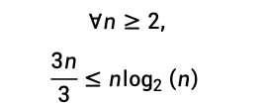
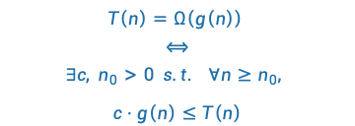

Example $$n\log_{2}\left(n\right)=Ω\left(3n\right)$$
$$T\left(n\right)=Ω\left(g\left(n\right)\right)$$
$$⟺$$
$$∃c, n_{0}>0 s.t. ∀n≥n_{0},$$
$$c⋅g\left(n\right)≤T\left(n\right)$$
g(n) = 3n
Choose c = 1/3
Choose n₀ = 2
Then
T(n) = nlog(n)
$$∀n≥2,$$
$$\frac{3n}{3}≤n\log_{2}\left(n\right)⁡$$
g(n)/3 = n

Slide 76
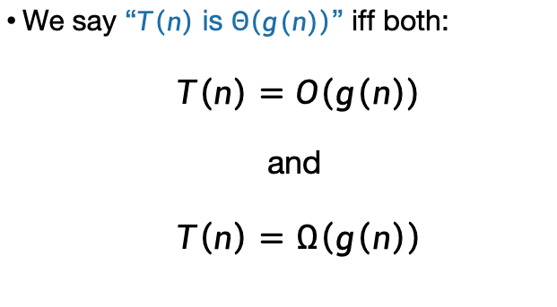
Θ(…) means both!
We say “$T\left(n\right)$ is $Θ\left(g(n)\right)$” iff both:
$T\left(n\right)=O\left(g\left(n\right)\right)$
and
$T\left(n\right)=Ω\left(g\left(n\right)\right)$

Slide 77

小o表示法
如果大O表示法可以类比于“小于等于”，则小o表示法可以类比于“严格小于”。
对任何常数c，都存在n₀, 使得 $T(n)≤c∙f(n)$
例如 $n^{k−1}=o(n^{k})$

Slide 78
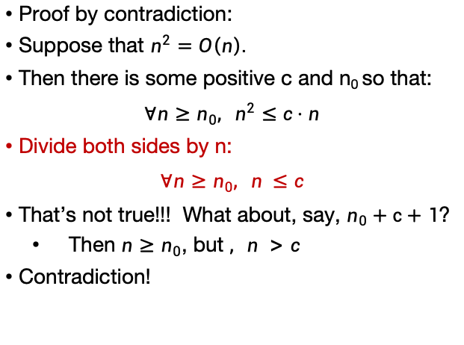
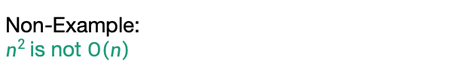
Non-Example: $n^{2 }$is not $O\left(n\right)$
$$T\left(n\right)=O\left(g\left(n\right)\right)$$
$$⟺$$
$$∃c, n_{0}>0 s.t. ∀n≥n_{0},$$
$$T\left(n\right)≤c⋅g(n)$$
Proof by contradiction:
Suppose that $n^{2}=O\left(n\right).$
Then there is some positive c and n₀ so that:
$$∀n≥n_{0}, n^{2}≤c⋅n$$
Divide both sides by n:
$$∀n≥n_{0}, n^{ }≤c$$
That’s not true!!! What about, say, $n_{0}+c+1$?
Then $n≥n_{0}$, but $, n^{ }>c$
Contradiction!

Slide 79
Take-away from examples
To prove T(n) = O(g(n)), you have to come up with c and n₀ so that the definition is satisfied.
To prove T(n) is NOT O(g(n)), one way is proof by contradiction:
Suppose (to get a contradiction) that someone gives you a c and an n₀ so that the definition is satisfied.
Show that this someone must by lying to you by deriving a contradiction.

Slide 80
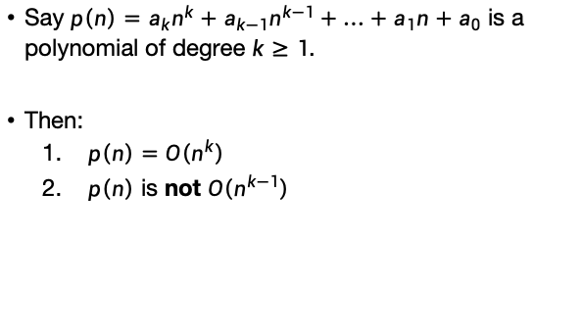
Another example: polynomials
Say $p\left(n\right)=a_{k}n^{k}+a_{k−1}n^{k−1}+…+a_{1}n+a_{0}$ is a polynomial of degree $k≥1$.
Then:
$p\left(n\right)=O\left(n^{k}\right)$
$p\left(n\right)$ is not $O\left(n^{k−1}\right)$
Try to prove it yourself first!
Siggi the Studious Stork

Slide 81

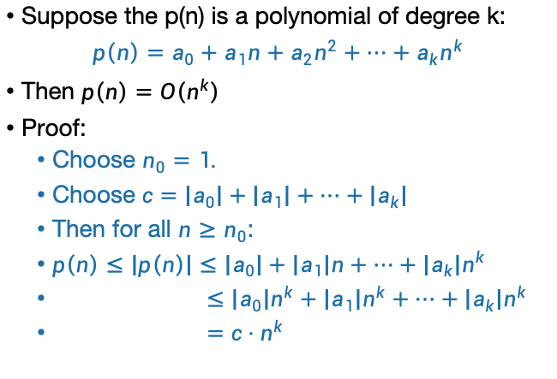
Another example: polynomials
SLIDE SKIPPED IN CLASS! (Note this is also in the reading).
Suppose the p(n) is a polynomial of degree k:
$p\left(n\right)=a_{0}+a_{1}n+a_{2}n^{2}+⋯+a_{k}n^{k}$
Then $p\left(n\right)=O\left(n^{k}\right)$
Proof:
Choose $n_{0}=1.$
Choose $c=\left|a_{0}\right|+\left|a_{1}\right|+⋯+\left|a_{k}\right|$
Then for all $n≥n_{0}$:
$p\left(n\right)≤\left|p\left(n\right)\right|≤\left|a_{0}\right|+\left|a_{1}\right|n+⋯+\left|a_{k}\right|n^{k}$
$≤\left|a_{0}\right|n^{k}+\left|a_{1}\right|n^{k}+⋯+\left|a_{k}\right|n^{k}$
$=c⋅n^{k}$
Triangle inequality!
Because $n≤n^{k}$ for $n≥n_{0}≥1.$
Definition of c

Slide 82
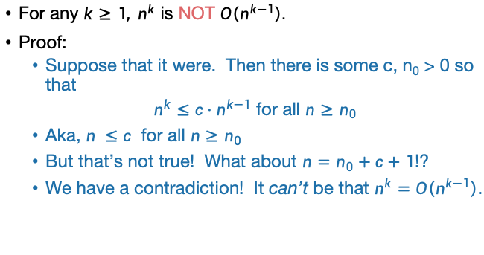
Example: more polynomials
For any $k≥1, n^{k}$ is NOT $O\left(n^{k−1}\right).$
Proof:
Suppose that it were. Then there is some c, n₀ > 0 so that
$n^{k}≤c⋅n^{k−1}$ for all $n≥n_{0}$
Aka, $n^{ }≤c$ for all $n≥n_{0}$
But that’s not true! What about $n=n_{0}+c+1$!?
We have a contradiction! It can’t be that $n^{k}=O\left(n^{k−1}\right)$.

Slide 83



More examples
If
We prove by contradiction.
Suppose $T\left(n\right)=O\left(2^{n}\right),$then there exist c and n₀, such that
$∀ n≥n0$, ${ 2}^{10n}≤c$ $2^{n}$
So ${ ∀ n≥n0, 2}^{9n}≤c$, which arrives at a contradiction.
So $T\left(n\right) is not O(2^{n})$
Q.e.d

Slide 84
Exercises
n³ + 3n = O(n³ – n²)
n³ + 3n = Ω(n³ – n²)
n³ + 3n = Θ(n³ – n²)
3^{n} is NOT O(2^{n})
log₂(n) = Ω(ln(n))
log₂(n) = Θ( 2^{loglog(n)} )
Work through these on your own! Also look at the examples in the reading!
Siggi the Studious Stork
Notes:
C=2, n0=3
C=1, n0=1;
C=1, n0=1

Slide 85
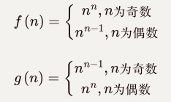

Some brainteasers
Are there functions f, g so that NEITHER f = O(g) nor f = Ω(g)?
Are there non-decreasing functions f, g so that the above is true?
例如：
例如：
两者关系忽大忽小交替出现
Notes:
F=10^(-11n) g=10^n

Slide 86
什么是快速算法
“快速算法”是指在最坏情况下运行时间随着输入长度的增加缓慢增长。
缓慢增长的含义是什么呢？
目标：O(n)，线性时间
近似线性：例如 O(nlogn) 温和超线性
无代价的算法
把具有线性或者近似线性时间的算法看做“无代价使用”的算法，因其比读入输入所需的时间多不了多少。

Slide 87
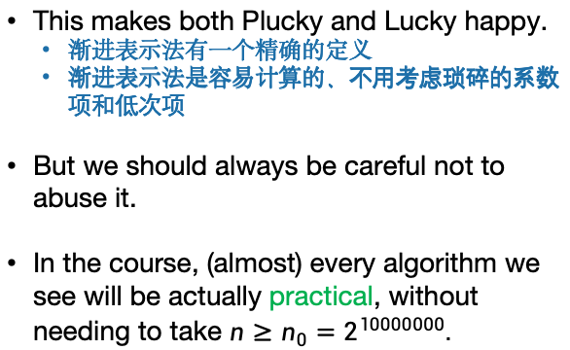
Recap: Asymptotic Notation
This is my happy face!
This makes both Plucky and Lucky happy.
渐进表示法有一个精确的定义
渐进表示法是容易计算的、不用考虑琐碎的系数项和低次项
But we should always be careful not to abuse it.
In the course, (almost) every algorithm we see will be actually practical, without needing to take $n≥n_{0}=2^{10000000}.$

Slide 88
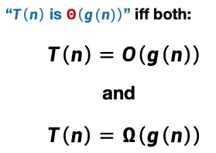
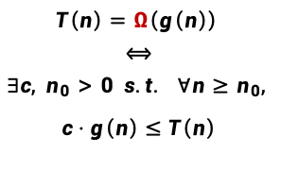
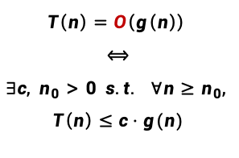
总结：Asymptotic Analysis
算法分析的三个指导原则
最坏情况分析
忽略常数因子和低阶项
渐进分析
$$T\left(n\right)=O\left(g\left(n\right)\right)$$
$$⟺$$
$$∃c, n_{0}>0 s.t. ∀n≥n_{0},$$
$$T\left(n\right)≤c⋅g(n)$$
“$T\left(n\right)$ is $Θ\left(g(n)\right)$” iff both:
$T\left(n\right)=O\left(g\left(n\right)\right)$
and
$T\left(n\right)=Ω\left(g\left(n\right)\right)$
$$T\left(n\right)=Ω\left(g\left(n\right)\right)$$
$$⟺$$
$$∃c, n_{0}>0 s.t. ∀n≥n_{0},$$
$$c⋅g\left(n\right)≤T\left(n\right)$$

Slide 89
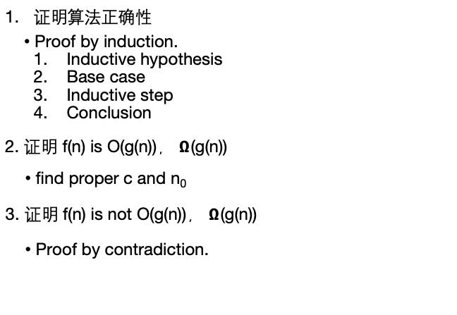
总结：几个证明
证明算法正确性
Proof by induction.
Inductive hypothesis
Base case
Inductive step
Conclusion
2. 证明 f(n) is O(g(n))， $Ω$(g(n))
find proper c and n₀
3. 证明 f(n) is not O(g(n))， $Ω$(g(n))
Proof by contradiction.

